Slide 1

Trends in Infection Prevention
and Control:
Discovering A New Perspective
Yves Crehore
Adam Scott
RN, ICP
Product Manager
RL Solutions
Sales Manager, Infection Prevention and Antimicrobial Stewardship
RL Solutions

Slide 2

Meet the presenters
Yves Crehore
RN, ICP, Product Manager
RL Solutions
As the Infection Product Manager, Yves' day to day involves the innovating and improving of our products to directly impact patient care and outcomes. Off the clock, you can find him being a Poppi to his twin girls, which in his opinion is the best job and hobby in the World!

Slide 3

Meet the presenters
Adam Scott
Sales Manager, Infection Prevention and
Antimicrobial Stewardship
RL Solutions
Adam started at RL as a co-op student 5 years ago. Since then, he's grown into the Sales Manager role for Infection Surveillance and Antimicrobial Stewardship. Off the clock, you can find Adam at the golf course hoping to get his shot at the PGA.

Slide 4

RL webinar series
Free webinars delivered by RL business partners, clients and industry experts
Healthcare industry topics and best practices
Send questions and ideas to webinars@rlsolutions.com

Slide 6
Introductions
Five Emerging and Continuing Trends in Infection Control
Role of Technology within Infection Control
Q&A

Slide 7
“A tumultuous year for the
healthcare industry.”
In 2017, we’ve witnessed the industry & government policy changes, healthcare retailization increasing, resulting in many mergers and acquisitions.
Michael J. Dowling, President & CEO, Northwell Health | December 18, 2017 https://www.beckershospitalreview.com/hospital-management-administration/michael-dowling-4-most-important-healthcare-trends-in-2018.html

Slide 8
2018 thus far appears to be
an acceleration of 2017.
Organizations are adapting and responding to this changing landscape as it happens. A strong emphasis on adapting to change will be key to staying competitive, as will be innovation and a superior customer experience.
Michael J. Dowling, President & CEO, Northwell Health | December 18, 2017 https://www.beckershospitalreview.com/hospital-management-administration/michael-dowling-4-most-important-healthcare-trends-in-2018.html

Slide 9

Notes:
In this webinar, will be discussing 5 trends in healthcare which are impacting Infection Prevention Teams
Consumers expecting care in a more friendly environments
Providing hospital care in non- hospital environments
Resurgence of old pathogens
Evolving and ever changing antibiotic resistance
Meaningful Data Analytics and Care

Slide 10

Notes:
So let's talk about............

Slide 11

Consumers Expect Care in More Consumer–Friendly Environments
Notes:
Care environments are evolving to be more "Patient Centric" from the patients perspective.

Slide 12
Changes in the design of healthcare facilities
Facilities are being designed with a more home or hotel like care setting.
Less clinical and more calmer environments are aimed to increase Patient Satisfaction Scores and to influence consumer care choices.
Infection Control Teams are increasingly involved with material selections for products used in care that reduce or limit bioburden and still provide comfort.
Notes:
Could Adam ask Yves: "How does the perception of the patient/family change in this new less clinical appearing space"

Slide 13

Notes:
A related trend evolving "Providing Hospital Level Care in a non-hospital environments"

Slide 14

Providing Hospital Level Care in
Non-Hospital Environments

Slide 15
Services outside of hospital environments
Out-patient care clinics are now providing services in commercial spaces and retail venues to reduce overhead costs and cater to the patients.
As the boundaries begin to blur between clinically defined environments and the historically outside world, Infection teams are faced with new challenges.
Notes:
Walmart pioneered the $4 prescription for a generic in 2006. Today, Walmart’s vision care department serves up more pairs of prescription glasses than any other retail outlet in America. The company has operated urgent care clinics for years, and recently introduced a new primary care clinic concept where, for $4, a Walmart employee can receive a physician visit; for a non-Walmart employee, the cost is $40.
Well what are some of those Challenges?

Slide 16
Services outside of hospital environments
Communicable diseases surveillance will need to evolve into managing the potentially transmission risks inherent in an intermingling transient population.
Maintaining environmental control boundaries between the retail environment and the clinical environment is challenging. Retailers are unfamiliar with the levels of environmental controls or importance of zone monitoring to prevent transmission of pathogens in either direction.

Slide 17


Slide 18

The Resurgence of Old Diseases
Providing Hospital Level Care in
Non-Hospital Environments

Slide 19
Low Vaccine Adherence – population immunity
Mis-information is leading to lower vaccine adherence, coupled with waning population immunity resulting in the resurgence of vaccine preventable diseases.*
In 2009, increase cases of Scarlet fever were noted in South Korea, the Chinese mainland and Vietnam.
*Data retrieved from: NCBI Article: Association Between Vaccine Refusal and Vaccine-Preventable Diseases in the United States – A Review of Measles and Pertussis: https://www.ncbi.nlm.nih.gov/pmc/articles/PMC5007135/

Slide 20
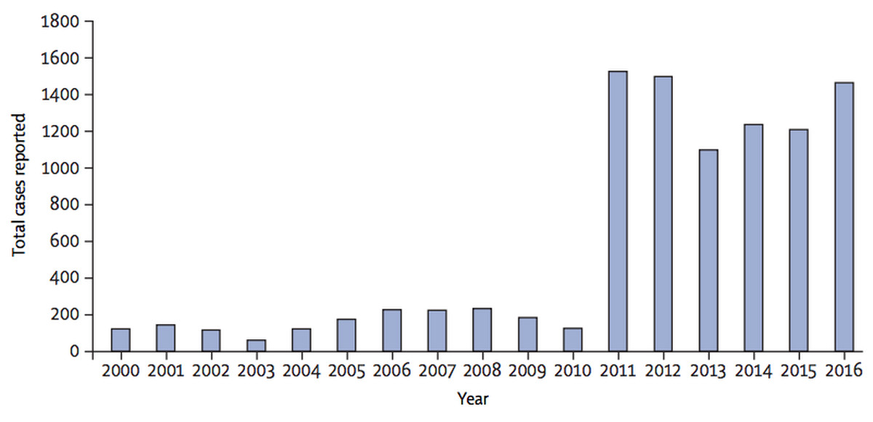
The Mysterious Return of Scarlet Fever
A Lancet Study: England and Wales saw three times more Scarlet Fever cases in 2014 than previous years and highest rate in 50 years.
Scarlet Fever was the number one killer of children in the 19th and 20th century – and it’s back!
Annual reported scarlet fever cases in Hong Kong.
*Image retrieved from: Vox Article: The Mysterious Return of Scarlet Fever; https://www.vox.com/2017/11/30/16720794/scarlet-fever-return

Slide 21
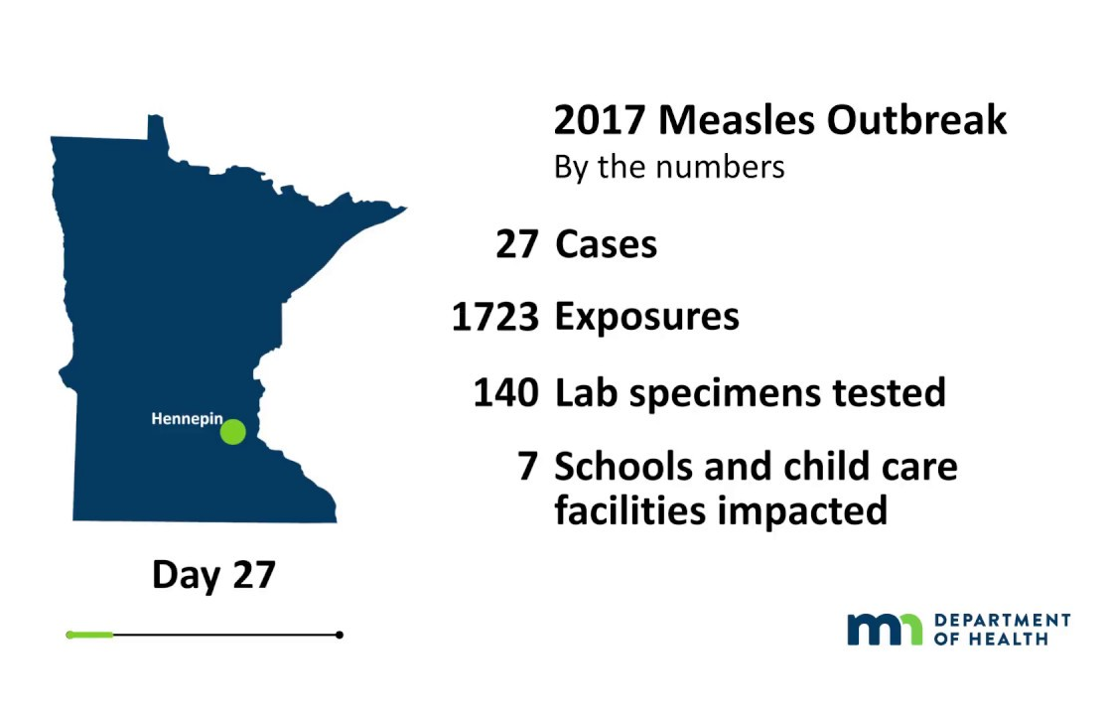
MINNESOTA HEALTH CARE BATTLE WITH MEASLES
In the Spring and Summer of 2017, the Minnesota Department of Health (MDH) in the United States battled with resurgence of measles
MDH estimated its costs for the outbreak response were more than $900,000 and Hennepin County estimated its costs at about $400,000
*Image retrieved from: Minnesota Depart of Health YouTube channel; https://www.youtube.com/watch?v=nc1ZU_zVsfA

Slide 22
The measles outbreak resulted in:
More than 8,000 people exposed to measles
More than 500 people asked to stay home from school, child care or work because they were potentially infectious (unvaccinated and exposed to someone infectious)
22 people hospitalized
73 cases under 10 years old
71 of the cases unvaccinated for measles
70 cases in Hennepin County, but also three in Ramsey County, four in Crow Wing and two in Le Sueur counties.
*Data retrieved from: Minnesota Depart of Health website; http://www.health.state.mn.us/news/pressrel/2017/measles082517.html
Notes:
So we have waning vaccination adherance being one contributable factor, what about things like environmental climate change?

Slide 23


Slide 24

Evolving Antibiotic Resistance

Slide 25
The who priority pathogens list
Priority 1
Acinetobacter baumannii, carbapenem-resistant
Priority 2
Enterococcus faecium, vancomycin-resistant
Priority 3
Streptococcus pneumoniae, penicillin-non-susceptible
Pseudomonas aeruginosa, carbapenem-resistant
Enterobacteriaceae, carbapenem-resistant, ESBL-producing
Staphylococcus aureus, methicillin-resistant, vancomycin-intermediate and resistant
Helicobacter pylori, clarithromycin-resistant
Campylobacter spp., fluoroquinolone-resistant
Salmonellae, fluoroquinolone-resistant
Neisseria gonorrhoeae, cephalosporin-resistant, fluoroquinolone-resistant
Haemophilus influenzae, ampicillin-resistant
Shigella spp., fluoroquinolone-resistant
*Data retrieved from: WHO website: http://www.who.int/news-room/detail/27-02-2017-who-publishes-list-of-bacteria-for-which-new-antibiotics-are-urgently-needed

Slide 26
2018: Issue of Antibiotic resistance
Antibiotic resistance becoming a major patient safety issue and concern for hospitals globally.
In the United States each year, at least 2 million people become infected with bacteria that are resistant to antibiotics and at least 23,000 people die each year as a direct result of these infections.*
To combat and track these pathogens U.S health officials will continue to track and monitor HAI’s and drug resistance.
*Data retrieved from: CDC website: https://www.cdc.gov/drugresistance/index.html

Slide 27
2018: Issue of Antibiotic resistance
Catheter Related Blood Stream Infections, Surgical Site Infections, Ventilatory Associated Pneumonias and Catheter-associated Urinary Tract Infections continue to be central in the CDC surveillance strategy.
Mortality rates for carbapenem-resistant Enterobacteriaceae cause an estimated 600 deaths each year and 9,300 infections according to the CDC.*
*Data retrieved from: Arstechnica article: Deadly Superbug Just Got Scarier – It Can Mysteriously Thwart Last-Resort Drug by Beth Mole: https://arstechnica.com/science/2018/03/scary-superbug-can-sneakily-dodge-last-resort-drug-and-we-dont-know-how/
Notes:
Deadly superbug just got scarier—it can mysteriously thwart last-resort drug
It's the first time researchers have seen colistin-heteroresistant germs in the US.
BETH MOLE - 3/9/2018, 9:51 AM
https://arstechnica.com/science/2018/03/scary-superbug-can-sneakily-dodge-last-resort-drug-and-we-dont-know-how/

Slide 28
2018: Issue of Antibiotic resistance
Tracking existing and emerging resistance is a priority for all levels of health care. Organizations such as the National Quality Forum, CDC and the Society for Healthcare Epidemiology of America continue to advise and evolve tools to track and improve antibiotic stewardship programs.

Slide 29
Up to 50% of antibiotics are not properly prescribed or administered. Ensure antimicrobials should be considered in the light of the following considerations
  The Right Drug matched to the Right Bug is critical
  The Right dose
  The Right duration
  The Right route of delivery
Trends of Drug Resistance
Global review of antibiotic use in food chain management. Food recalls are increasing due to contamination with drug resistant bacterium such as Campylobacter, Salmonella and Listeria.
Environments are examined for potential to harbor or facilitate the transmission of drug resistant pathogens e.g. water sources, common surfaces and heating ventilation and cooling systems (HVAC).

Slide 30


Slide 31

Meaningful Data Analytics in Healthcare

Slide 32
Making your data work for you
Infection Control Teams are charged with identifying evolving communicable disease events both within their care continuum and outside of their care catchment along with juggling their daily tasks.
Electronic Surveillance Systems have helped to automate and alert practitioners to changing landscapes within their very institutions by identifying trends and structuring data in such a way that teams can begin discerning causation and correlation of events.
Notes:
Talking point to the first bullet: Combined socioeconomic factors, geography, individual health histories and institutional bioburdens converge to make this a complex and daunting task at the best of times however, new tools are evolving for Infection Teams.
Talking point to the second bullet: Infection teams using an electronic surveillance system benefit by identifying unusual or important pathogens in real time. Customized alerting provides teams with immediate notification of pathogens of interest or as soon as laboratory results are available. Geospatial mapping of locations enhances outbreak management and line tracing of patients, staff and equipment quickly compared to many hours or days of manual investigation.

Slide 33
Making your data work for you
Infection Preventionists require data to be able to act upon and get ahead of potential harm. Manually collecting this data takes time away from other critical functions such as clinical rounding and education.
The evolution of Infection Surveillance Systems is providing new solutions to assist with these tasks, leaving more time for Infection Preventionists to apply their skills to affect positive changes within their facilities, instead of spending their time collecting and sifting through mountains of data trying to discern meaning.
Notes:
Talking point to first bullet: Data such as patient identification, admission and discharge dates, types of specimen, culture results, location of collection, location of patient, admitting diagnosis and antibiotic orders, are just a few pieces which need to be analyzed, interpreted and confirmed.
Talking points for second bullet: Which is what we are doing with RL6:Infection

Slide 34

Bullet points with headers
RL6:Infection
Notes:
These trends are evolving and changing the landscape that infection control teams have to practice in. Whether there are new diseases that are present within a community or identifying imminent outbreaks, it is critical that teams are responsive.
Through the partnerships with our clients, we aim to support infection control teams infection surveillance software

Slide 35

Discovering A New Perspective
Surveillance and
Analytics
Critical Decision
Support
Help Prevent HAIs

Slide 36

Adapting and Staying Ahead
Real-Time Infection
Surveillance
Context Based Syndromic
Surveillance
Hand Hygiene Audits
Outbreak Management
Antimicrobial Stewardship
NHSN Reporting

Slide 37
Yves Crehore
ycrehore@rlsolutions.com
Adam Scott
ascott@rlsolutions.com

