Slide 1
Getting to the Root Cause with RL6
John Campbell
Product Manager
RL Solutions

Slide 2
Meet the presenter
John Campbell
Product Manager RL Solutions
As part of the Product Management team, John is passionate about helping clients work efficiently and providing them with additional value in their RL6 products. He also coaches the RL softball team (RBI Solutions) and helps organize RL’s annual Table Tennis tournament, where he reprises his role as Chairman of RL Stadium each year.

Slide 3
RL webinar series
Free webinars delivered by RL business partners, clients and industry experts
Healthcare industry topics and best practices
Send questions and ideas to webinars@rlsolutions.com

Slide 5
Introductions
Product Evolution
Client Story: Customizing RootCause
Multiple Framework Support
Client Story: Moving to RCA²
Q&A

Slide 6
Root Cause Analysis
Structured methodology
Used by a multidisciplinary team
Helps Identify underlying problems
Avoids focusing on individual mistakes
Prevents future harm by eliminating latent errors

Slide 7
RL6:RootCause
A key module of the RL6 platform
Facilitates deep-dive investigations
Provides a timeline feature for documenting key events
Allows actions to be assigned to non-module or RL6 users

Slide 8
File Creation

Slide 9
Choose a Destination Module

Slide 10
Send Data to RCA and Link the Files

Slide 11
Navigate to The New RCA File

Slide 12
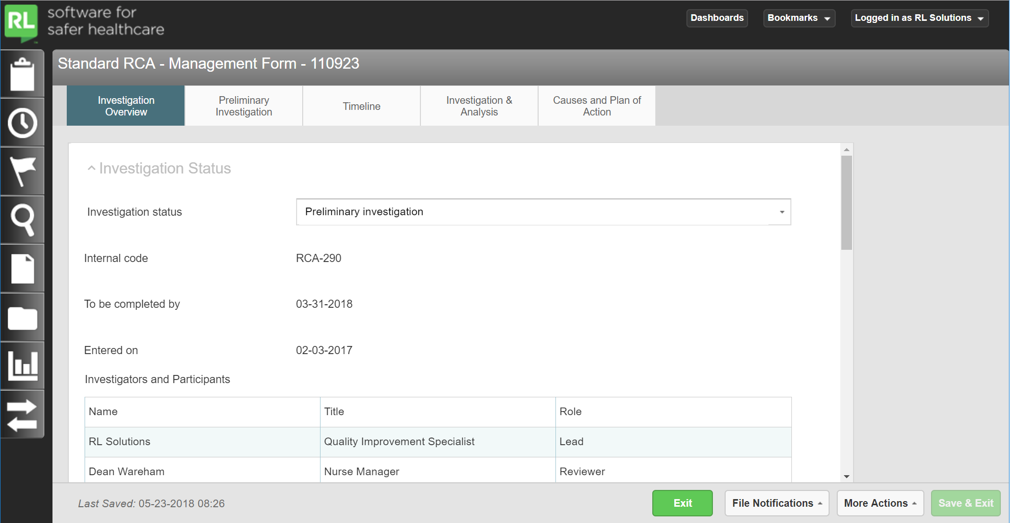
Navigate to The New RCA File

Slide 13
Investigation overview

Slide 14
Investigation overview

Slide 15
Preliminary Investigation

Slide 16
Preliminary Investigation

Slide 17
Build a Timeline of critical events

Slide 18
Build a Timeline of critical events

Slide 19
Build a Timeline of critical events

Slide 20
Create and document Investigation Items

Slide 21
Create and document Investigation Items

Slide 22
Create and document Investigation Items

Slide 23
Create and document Investigation Items

Slide 24
Create and document Investigation Items

Slide 25
Creating Action plans and Action items

Slide 26
Creating Action plans and Action items

Slide 27
Creating Action plans and Action items

Slide 28
Learning and Analysis

Slide 29
Learning and Analysis

Slide 30
Learning and Analysis

Slide 31
Product Evolution

Slide 32
Changing Landscape
Mergers & Acquisitions
Facility types (e.g., ambulatory v. acute care v. long-term care)
Regional differences (e.g., NYPORTS v. Joint Commission)
Organizational culture

Slide 33
Changing Landscape
Frameworks
RCA²
Joint Commission
Homegrown processes
External consultants and vendors

Slide 34
Changing Landscape
Thought Leadership
Looking outside of healthcare for inspiration
Trying to add elements of Just Culture
Including HRO concepts
Quick, less formal

Slide 35
RL6:RootCause History
Initial Release (2013)
Geared to Joint Commission Framework
Minimal configuration points
Increased Flexibility
Flexible “Event Details” area
Customizable question library
Improved Interoperability
Full Flexibility (2017)

Slide 36
Flexibility

Slide 37
include, remove or Create New Tabs

Slide 38
include, remove or Create New Tabs

Slide 39
Embed Business Logic into forms

Slide 40
Embed Business Logic into forms

Slide 41
Configurable External Action Form
Include information from the Action Plan
Action plan summary
Action plan details
Include information from elsewhere in the file
Timeline
Investigation overview
Custom questions and details

Slide 42
New Root Cause Features

Slide 43
Relaxed Workflow Requirements
Enforced progression through tabs was too restrictive
Allow users to start anywhere in the process
Create an Action Plan first for critical items
Start answering Investigation Items before documenting the timeline

Slide 44
Linking Component (6.7.1)
Previously there was a 1:1 relationship between Causal Factors and Action Plans.
Now a single action plan can address more than one causal factor or you might create multiple action plans for a single causal factor.

Slide 45
Import Investigation items

Slide 46
Timeline Attachments

Slide 47
Client Story

Slide 48
Meet the presenter
Sue Corkill
Clinical System Analyst
Bryan Health
Sue has been a nurse for 40 years and has been working in the Quality and Safety environment for the last 12 years. As the day-to-day manager for RL systems used at Bryan Medical Center, she is involved in all aspects of patient safety and approaches the RL products with the philosophy of making the systems work for Bryan Medical Center and not the other way around.

Slide 49
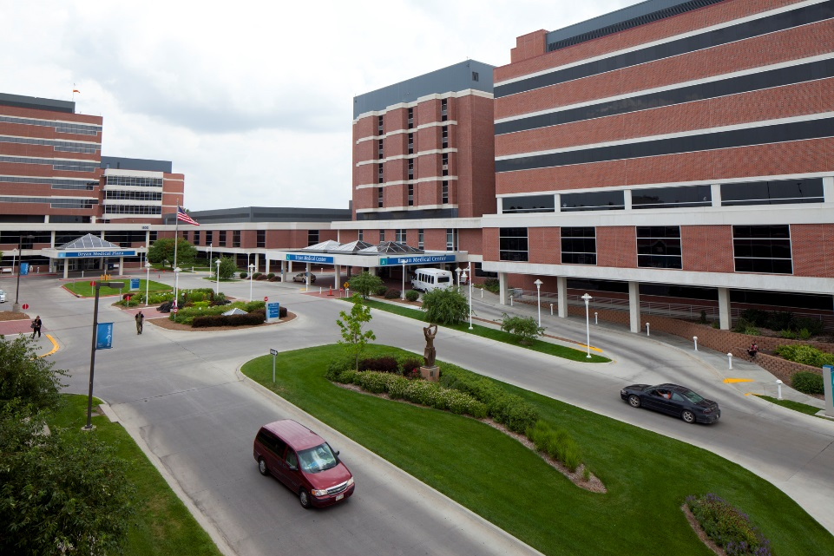
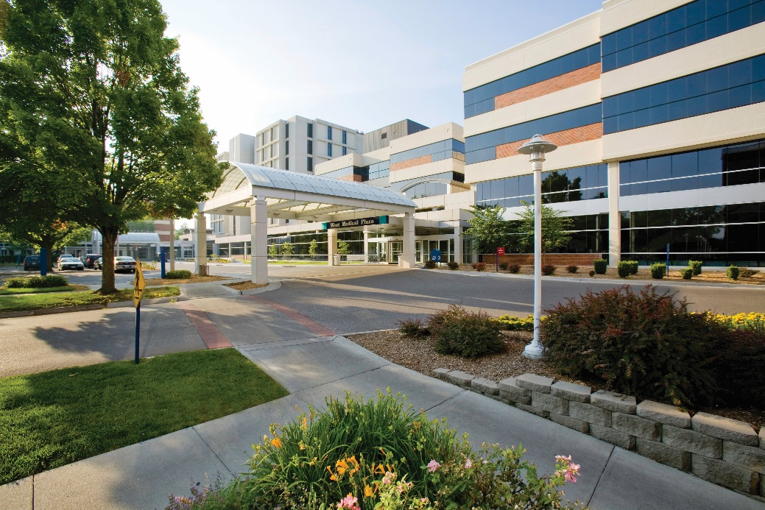
Bryan Medical Center
Not-for-profit medical center in Lincoln, Nebraska with 672 beds shared between two acute-care hospitals.
We provide all major services for Southeastern Nebraska, Southwestern Iowa, Northwestern Missouri and Northeastern Kansas; including trauma, inpatient mental health and substance abuse services.
In the past year we have conducted 3 RCAs and 26 Case Reviews.

Slide 50
RCA & Case Review Process
Event identified through a RL Risk file or phone call from the unit manager.
The risk file is transferred to the root cause module, which we then use to start the preliminary investigation and develop the timeline.
We use The Joint Commission structure present in the module for all our reviews. We also report to the Nebraska Patient Safety Coalition, which is our PSO.
Our RCA and case review process is basically the same; we follow the same procedure in determining proximal causes by review of the investigation questions, inputting the findings and determining if there was a root cause.

Slide 51
RCA & Case Review Process
We invite all involved with the event to the RCA/case review. Our philosophy is that it’s important to have the first-hand account from the participants and to provide a safe forum to discuss all aspects of the event. The timeline from the module is printed for participant use during the review.
Action items agreed upon at the review are entered into Causes and Plan of Action tab. This year we hope to start using the action follow-up tools available in the module.
The root cause module serves as the repository for all documents and information related to the event—we are working our way towards being paperless (and notebook-less).

Slide 52
RCA Module 6.7.0.2 Customization
Investigation Overview
Investigation Status: Drop down pick with choice of Preliminary investigation; Quality Improvement Case Review; RCA
Preliminary Investigation
Internal Code: Quality Specialist with primary responsibility for the review
Reason for RCA: Drop down pick with 27 specific event types—defined by our hospital policy/procedure

Slide 53
RCA Module 6.7.0.2 Customization
Investigators & Participants
Used as a sign-in sheet and to document who was invited and attended the review
Timeline
Printed for participant use during the review (we changed it to chronological order)

Slide 54
Standard RL6 Form Features

Slide 55
File Notifications

Slide 56
More Actions

Slide 57
Redacting Text

Slide 58
Constraint Set / Ratings Matrix

Slide 59
Instructional Text

Slide 60
Framework Support

Slide 61
Framework Support
Built in fields from a number of frameworks (6.7.0)
Included in section templates for easy deployment (6.7.1)

Slide 62
Different Root Cause Forms

Slide 63
Client Story

Slide 64
Meet the presenter
Renee King
Manager of Quality Transformation
Mercy Health
Renee is the Manager of Quality Transformation working on the Patient Safety and Quality Team of Mercy Health. In this role, Renee is responsible for the oversight and management of the event reporting system, facilitation of the Quality Steering Committee that guides Mercy Health’s strategic quality initiatives and is responsible for the monitoring/evaluation of all Serious Safety Events/Sentinel Events within Mercy Health’s facilities. Renee has worked for the system for 30 years.

Slide 65
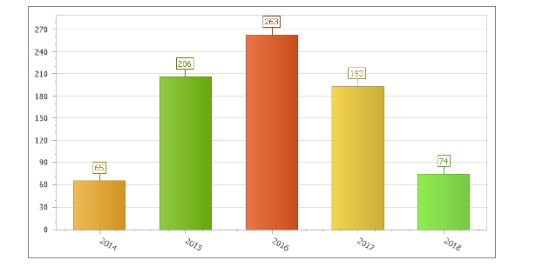
Mercy Health
Catholic, Non-Profit Health Ministry
4th largest employer in Ohio
32,000 employees
22 Acute Care Locations
14 Long Team Care Facilities
Exceeding 300 physician offices and ambulatory locations
RL6 implemented November 8, 2010 across entire ministry
Adopted the RCA module in late May, 2014

Slide 66
Mercy Health’s early adoption of RCA
Intended to standardize our RCA process
Utilized primarily for acute care locations
Developed a system work group to evaluate and track RCA group
System Sharing of best practices
Supported our Adverse Event Management Guidelines
Identified great variability in strength of action plans
Identified great variability in completion of action plans
Wide variation in adoption of RCA database

Slide 67
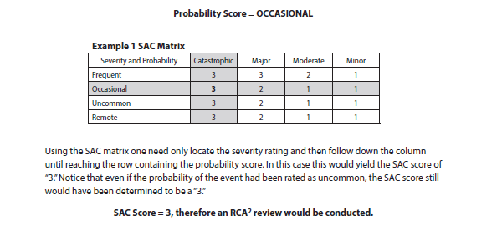
Mercy Health’s upgrade to 6.7.1
Completed upgrade 5/2/2018
Rolling out RCA²
Competed end of May 2018
Incorporating RCA2 language in Risk and RCA module
Risk Matrix is now in the Risk module as the decision tool to determine RCA assignment
RCA² language incorporated into our Severity Outcome scale in Risk to further support Risk Matrix decision

Slide 68
RCA improvements
Alert triggers in Risk fire to Quality/Risk officers for evaluation of potential Sentinel Events and Serious Safety Events – NQF definitions incorporated
Incorporated Executive Sponsor sign off fields into RCA
Improved tracking of RCA completion with reports that support RCA 45 day completion tracking
Action alerts now allow RCA owner to extend the deadline or reassign
Incorporating language to support and drive sustainability in actions
Timeline improvements – quicker entry, attach documents
Overall RCA product is highly customizable and allows multiple forms

Slide 69
Mercy Health next steps
Developed system wide committee that meets every 2 weeks to evaluate RCAs that are reported
Develop reports within RCA to support this
Develop system wide method for sharing systemic and isolated events for learning and harm prevention
Develop reports within RCA to support this

Slide 70
John Campbell
jcampbell@rlsolutions.com

