Slide 1
Safety First: The Journey to Develop a Workplace Violence Prevention Program
Carrie Arrieta, CPHRM
Risk Manager
North Shore Medical Center

Slide 2
Meet the presenter
Carrie Arrieta, CPHRM
Risk Manager North Shore Medical Center
Carrie Arrieta is a Risk Manager at North Shore Medical Center, part of Partners Healthcare. She manages a facility-wide risk program, working collaboratively with physicians, clinical staff and other key stakeholders in advising and supporting on all risk management issues.

Slide 3
RL webinar series
Free webinars delivered by RL business partners, clients and industry experts
Healthcare industry topics and best practices
Send questions and ideas to webinars@rlsolutions.com

Slide 5
Susan’s Story
The Problem – Honing in on the source of truth
RL and Workplace Violence
The Data and Trends Identified
Staff Feedback
Our Programs
Next Steps
Q&A

Slide 6
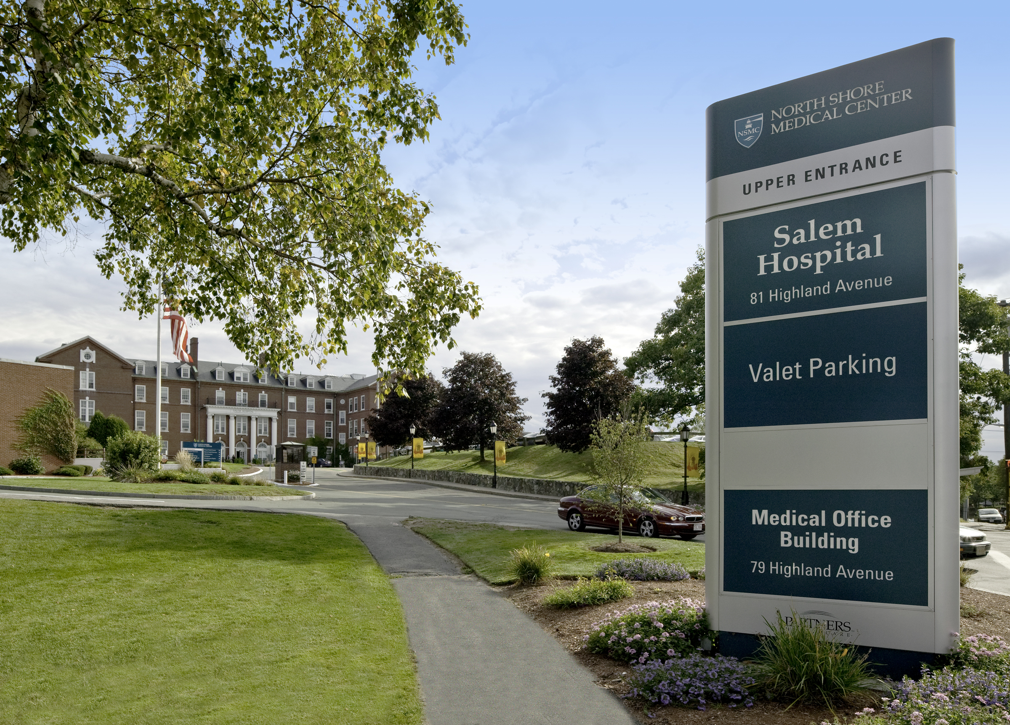
About north shore medical center (NSMC)
North Shore Medical Center (NSMC) is located in Salem, Massachusetts, with a campus in Lynn, MA and is one the largest healthcare providers north of Boston.
A member of Partners HealthCare, founded by Brigham and Women’s Hospital and Massachusetts General Hospital
372 beds - acute care Level III Trauma facility
Over 90,000 patients seen in our 3 Emergency Departments every year
3 Inpatient psychiatric units
Safety Net hospital, providing essential health services to uninsured and underinsured Massachusetts residents

Slide 7
Susan’s story
Notes:
A 24-year-old male unfamiliar to us with a history of depression, presented to the ED, with his mother with increasing symptoms of depression. He reported that he had recently suffered the death of a friend and was experiencing a significant amount of stressors and had been taking his grandmother’s medication. He denied suicidal or homicidal ideation and denied psychotic symptoms. “He looked harmless.” He was cleared medically for evaluation by the mental health team. He received and took his evening medications at 11:00pm with his father present. His father left. Nursing hand-off. At around 12:15am, his new nurse, Susan, went to check on the patient and noticed that he had closed the door to his room and saw the patient looking out of the window and appeared to be talking. (happened to be in seclusion room) She went to the room and began to unlock and open the door. The patient suddenly became very agitated and began to slam heavy metal door repeatedly on Susan’s leg while pulling her into the room and slamming her in the door. He was screaming that people were trying to kill him. She called out and other staff and security staff immediately responded to assist. This nurse and other staff assisted the patient with medications to help with his agitation. The patient stated that he thought someone was trying to kill him. The nurse was seen and was evaluated to have a non-displaced fracture of the left tibial plateau. She was out of work for over 2 months. (Debrief, court, lessons learned, EAP and staff support, placement of seclusion room, looks were deceiving, long time for psych eval).

Slide 8
Workplace violence
A hospital is one of the most hazardous places to work. Injury rates in hospitals remain nearly double the rate for private industry as a whole, and is higher than the rates in construction and manufacturing. Healthcare accounts for nearly as many serious violent injuries as all other industries combined.
(OSHA)

Slide 9
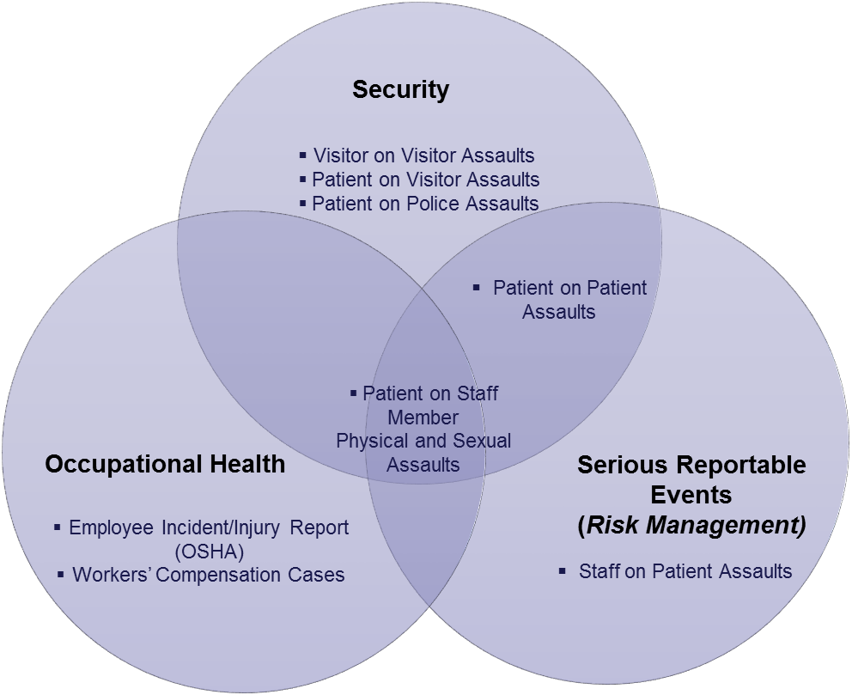
Honing In On The Source Of Truth
Our problem: Silos of workplace safety / assault data
Notes:
Security data: Assaults during which security is called to respond. Security is not called to respond for all assaults.
Occupational Health data: Assaults reported by staff to NSMC Occupational Health Services.
“Serious Reportable Event” (SRE) data: Physical assaults that meet the Massachusetts Department of Public Health “serious injury” criteria (where the staff member is out of work as a result of physical and/or emotional injury for 3 or more days); and, sexual assaults. Massachusetts requires reporting of the 28? SREs, including assaults on patients/staff.

Slide 10
Honing in on the source of truth (CONT.)
January 2015: NSMC formed a workgroup to track data (Risk Management, Security, Occupational Health
Defined assault
Assault: A physical attack upon another; an attempt to do violence to another.
Identified multiple data sources and different taxonomies
RL, Security Reports, Occupational Health tracking system, Serious Reportable Events (DPH)

Slide 11
RL and Workplace Violence
NSMC tracks these events in RL under “Safety / Security”
Abuse/Assault by a Patient
Abuse/Assault of a Patient
Disorderly Person
Intimidating/Disruptive Behavior by Patient
Intimidating/Disruptive Behavior by Visitor
Physical Assault/Battery by/on a Staff Member
Sexual Assault/Abuse by/on a Patient
Sexual Assault/Abuse By/ on a Staff Member
Threats of Violence
Weapons
Destruction of Property

Slide 12
RL and Workplace Violence (cont.)
July 2012: Formal implementation of multiple workplace violence event categories
October 2014: Fields for tracking Department of Public Health “Serious Reportable Events (SREs)” added
January 2016: Employee events added for Occupational Health
September 2017: The “Person Affected” Details section was renamed to “Patient/Visitor Involved” to alleviate confusion in the system

Slide 13
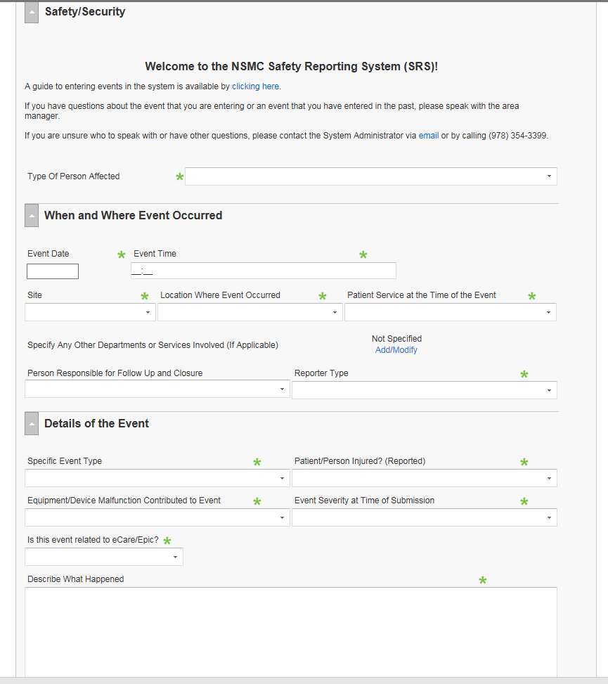

Slide 14
RL Data
* Need to scrub data monthly
Notes:
* Employees will often report events under the Employee General Event Type under the “Struck By” or “Workplace Injury/Trauma” specific event types. Events are updated to Safety/Security by Quality Data Analyst and changed to one of the specific event types above.
Staff may enter two events for one incident (especially if between two patients)

Slide 15
RL Data (Cont.)

Slide 16
New Method of Combined Data
January 2015: Data is compared, reconciled and combined
Still a manual process
We now collect and measure physical and sexual assaults using a common taxonomy, and sort and trend them by:
type;
severity (0-4);
location;
date and time;
person assaulted; and,
person doing the assaulting
Notes:
We don’t differentiate between intentional and organic

Slide 17
Combined Data: Assaults

Slide 18
Combined Data: Current Prevalence of Violence
Salem | CY 2015 | CY 2016 | CY 2017 YTD | 2017 Annualized
Security Alert | 339 | 292 | 252 | 378
Restraints | 209 | 276 | 215 | 322
Assaults * | 131 | 183 | 138 | 207
Weapons confiscated | 17 | 33 | 44 | 60
Union
Security Alert | 157 | 161 | 129 | 193
Restraints | 258 | 261 | 216 | 324
Assaults * | 264 | 184 | 113 | 169
Weapons confiscated | 53 | 75 | 39 | 58
2016 | 235 lost work days
2017 YTD | 126 lost work days
Notes:
Assault statistics compiled from Occupational Health, Security reports and Safety Events.
Examples of weapons include: knives, Leatherman (with knife), razors (box cutters, straight edge, etc), filed down screwdriver, gun, wooden stakes, hammers, axes.
2017 YTD = January 1 – August 31

Slide 19
Combined Data: Trends
Psychiatric patients boarding in ED for several days, increased prevalence of violence
Need for safety plans, earlier intervention with psychiatry consultation and medications
“Frequent flyer” patients responsible for multiple incidents and assaults
Increasing violence in non-behavioral heath settings
Assaults most often on nurses/techs, security and mental health counselors

Slide 20
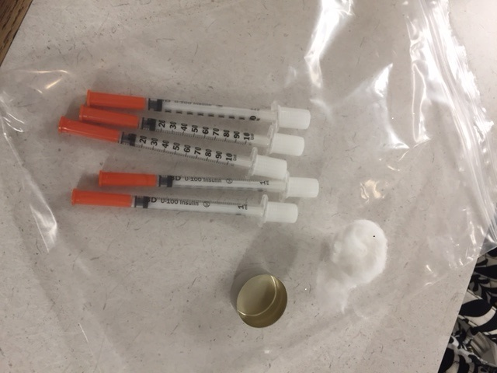
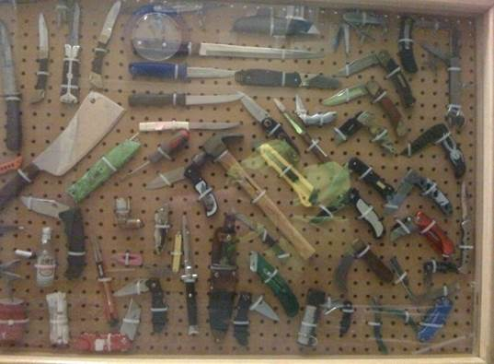
Combined Data: Trends (cont.)
Increase in incidents involving visitors
Assault incidents most often associated with patients experiencing: Withdrawal; Drug and Pain management issues; Mental health issues; Dementia and Delirium
Workplace violence and the national drug overdose epidemic (2107 overdose deaths in Mass in 2016)
Contraband issues, assaults, visitor issues, security alerts

Slide 21
Staff Feedback
March 2016: Distributed a “Workplace Safety Survey” to all staff, and compared our results with a similar survey to staff from 2012

Slide 22
Staff Feedback (cont.)

Slide 23
Staff Feedback (cont.)
20% have been assaulted in the workplace;
19% have been assaulted 1-5 times;
3% have been assaulted 5-10 times;
3% have been assaulted more than 10 times;
74% did not report an assault to anyone
21% have reported an assault to Security
Assaults are underreported by staff
“Just part of the job”
Patient’s history and condition - unintentional by patient and therefore accepted as routine or unavoidable
Inconsistent understanding of what constitutes an assault

Slide 24
Staff Feedback (cont.)
Assaults have a physical and emotional impact on staff who are victims. They also impact other staff who witness them and those who work in the same area
Staff experience of safety extends beyond the patient care or work unit
Parking lots, building access, hallways, evening and overnight, visitors, management and leadership support, criminal proceeding support
Staff feel like they don’t have the tools or support always to manage the increasingly complex patient population
Need:
- Safety education and awareness
- Physical security and access control
- Allocation of resources

Slide 25
Our Program: Committees
Workplace Safety Committee (multidisciplinary)
Environment of Care Committee
Monthly EOC Workgroup
Interdepartmental review and analysis of violent patient data (Risk Management, Security, Occ Health)
ED specific Workplace Safety group
Attended by front line staff, managers, security, risk management, patient relations
Telling the stories
Notes:
Presenting Data and sharing stories:

Slide 26
Our Program: Committees (cont.)
Workplace Safety Committee
Membership:
Director of Patient Safety
Risk Manager
Director of Security
Director of Facilities
Director of Occupational Health
Human Resources
Psychiatry Nurse Educator
Security Manager
Director of Nursing Quality
Nurse Directors
ED RN representative(s)
Med/Surg RN representative(s)
Safety Officer
Frequency of Meetings: Monthly (new)
Report Structure: Monthly report to EOC, Annual report to Quality and Professional Affairs Committee (QPAC)

Slide 27
Our Program: Interventions
1) Development of an alert in the electronic health record (Epic) and corresponding acute safety plan (direct response to survey)
“Safety risk patient: A patient whose behavior, medical status or characteristics pose an immediate threat to that patient’s safety, the safety of other patients or employees, or may otherwise compromise the delivery of safe health care.”
Safety Risk Flag (Green) and Acute (Safety) Care Plan (Pink) on banner

Slide 28
Our Program: Interventions
2) Opened a 6-bed Mental Health Unit in ED (April 2016)
3) Interdisciplinary real time huddles for challenging cases
4) Implementation of a staff assault debrief tool
5) Standardized Patient Search policy and procedure (July 2016)
6) Implementation of Special State Police Officers (November 2016)
7) Lockdown of Units (August 2017)
8) Committee for Managing the Patient Going through Withdrawal (September 2017)
9) Implementation of a formal Safety Escort policy (October 2017)
10) “Panic buttons” added throughout both campuses
Notes:
2. Decrease in restraints and assaults
4. Low impact to clinician time but high value added
5. Used to identify high risk patients and remove potentially dangerous items upon arrival in the ED, for the safety of both patient and staff. Searches are carried out by Security personnel and form is completed that follows patient. (response to Survey)
6. Partnership with local law enforcement and implementation of Special State Police Officer training for Security Officers - Licensed through Mass State Police (direct response to Survey)
7. Completed the installation of access control to secure all of our Inpatient Units (August 2017) (direct response to Survey) Units secure 8:00 pm – 6:00 am option to lock down unit with push of button 24/7
9. Panic: direct response to Survey and in-service rounds

Slide 29
Our Program: Education
RN and mental health specific orientation on caring for patients with psychiatric crises.
Management of Aggressive Behavior (MOAB) Training by Security for all staff (offered monthly to all staff)
In-services and forums on all Hospital Units on Safety and De-escalation Tips (September 2017)

Slide 30
Our Program: Education
Clarification on leaving “against medical advice” (AMA) and elopements
Security Alert Life Threatening Situation/Active Shooter training (annual)
“Tracer” rounds in all clinical areas by Security staff to include observations and interactions with staff regarding workplace safety issues (weekly)
Notes:
Tracer rounds are part of joint commission readiness efforts. The Tracer Tuesday Team is comprised of NSMC employees from different disciplines who act as in-house surveyors to assess the hospital’s integration of systems, policies and practices to match regulatory standards. This team interviews front-line staff as well as observe practice in order to proactively identify vulnerabilities in the care processes.

Slide 31
Next Steps and Ongoing Challenges
Signage in our Emergency Departments that promotes our commitment to a safe environment
Regular review and revisions to forms in RL to make the reporting easier and still get the information we need.
Better messaging to staff about Workplace Safety efforts and education
Tighter visitor access

Slide 32
Next Steps and Ongoing Challenges
Continue to encourage staff to report all incidents, regardless of severity
Provide staff support after a traumatic workplace violence event. Emotional impact is hard to measure
Employee Assistance Program
Peer support
More Unit-based Safety Rounding

Slide 34
Carrie Arrieta, CPHRM
North Shore Medical Center
978-354-3559
Carrieta@partners.org

