Slide 1
Notes:
We’re more than 150 employees with offices in 4 countries
Completely employee owned
Aside from our product we spend a lot of our time focused on R&D and the client experience
And we’ve been profitable for over 15 years

Slide 2
SURVEILLANCE
Notes:
This is our world class patient safety suite.
We evolved and built our product suite based on feedback from our clients and our products work together to make it easier for your departments to communicate with each other

Slide 3
Notes:
RL is all over the world including some of these countries
In fact, the entire country of Denmark implemented our Risk system to provide all their citizens the ability to report incidents.

Slide 4
Initial Stewardship Challenges
Building support
Adopting interventions
Overcoming obstacles
Awareness and education
Moving the program forward

Slide 5
Ongoing Stewardship Challenges
Retaining / building support
Responsiveness to conditions and events occurring
Communicating and proving effectiveness
Generation and distribution of measurements and metrics
Regulatory needs
Evaluating the patient experience

Slide 6
How we help you in your asp efforts
Re-direct time for program improvements
Increase accuracy & scope
Focus on outcomes and safer environment
Reduce unnecessary drug costs
On demand reporting including NHSN
Notes:
By adding all those feeds you’re able to:
be more responsive which leads to better patient outcomes
Have more time for prevention activities
Reduce drug spend with antimicrobial stewardship and patient census
We also make it easy for you to report to NHSN
Increase the accuracy and scope of things you can monitor like hand hygiene, outbreak management

Slide 7
Add Feeds, Get insights
Notes:
The back bone of the infection surveillance product is the ability to take feeds from all these systems and turn them into valuable insights.

Slide 8
Easy to use
Notes:
Script:
We took design cues from some of the leading consumer products like Apple, Amazon, Google and incorporated into our product for easy and user friendly experiences
This infection dashboard gives you the most important information
This is the first thing you see when they log in
Proactively monitors data for ‘situational’ risks
Notifies based on configurable business logic

Slide 9
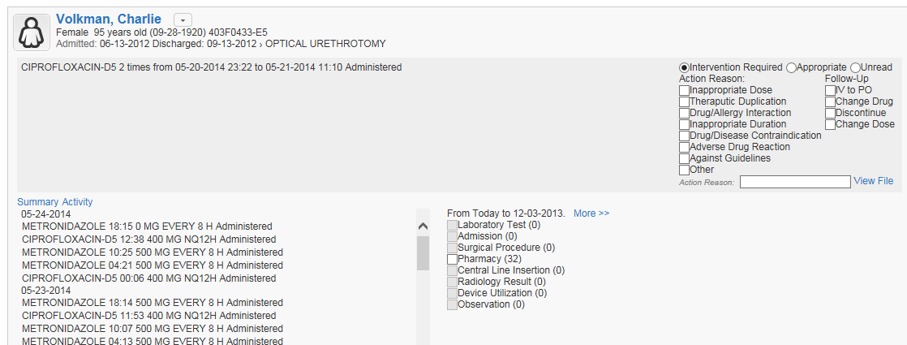
Right Drug/Right Time/Right Duration
Interventions
Flexible
Identification of obstacles
Communication OF Measurements / Metrics
Evaluation

Slide 10
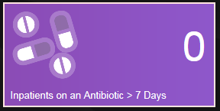
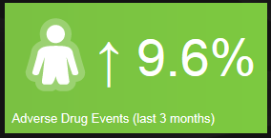
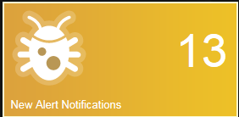
Right Drug/Right Time/Right Duration
Alerting
Drug/bug
Drug/Drug
Time/Duration based
Content Based
Volume Based

Slide 11
Prioritize at a glance
Surveillance results based on a logical business rules
Detailed data fields
Rounding sheets, case lists
Notes:
Management is made easier so you have more time to

Slide 12
Keep an eye on things while away
AMS on the go
Web based solution & mobile friendly
Even when you’re away from your desk
Walking the floor
On you way into work
Away at a conference

Slide 13
the info you need when you need it
Create your own reports
Powerful DIY report builder
Data exporting (NHSN)
Drill down to the details
Have the reports you need for committee meetings and AMS stakeholders
Notes:
Benefit: you don’t need IT or an analyst to build reports for you anymore
Because: you can build your own reports
Tell me more:
We have a powerful report builder tool
You can drill down to the level of detail you need: how many falls did I have in the emergency department last month. And pull a list of who the patients were
And we all know you guys have a lot of different committee meetings. Bring the right reports to the different meetings.

Slide 14
Be compliant
Built in compliance audits
Create user-defined audits to ID deficiencies
Risk matrix helps prioritize
Manage responsibilities and follow-up actions

Slide 15
demonstration

Slide 16
Implementation Services
Four defines
phases
Clear
milestones
Goals
Train the trainer Be self sufficient Minimize disruption
Notes:
Talk about the 4 things.
*4 phases
*clear milestones
*goals
*we do our best to make it fun
Basically our Philosophy is to instill confidence and build competence

Slide 17
Closing thoughts
System is designed to give you real time information
System accelerates communication at all levels
System retrieves supporting metrics and measurements
System provides flexibility for changing needs for quick adoption

Slide 18
Q&A

